Slide 1
Stock Market API Data Analysis Using Kafka
Alex Gheoca
08/28/19

Slide 2
Introduction
The data set you plan to study
Alpha Vantage API
https://www.alphavantage.co
Real Time Data
Which parts of the Big Data technologies you anticipate using to study it
Kafka through https://www.cloudkarafka.com/
Python
Kafka Producer/Consumer
Questions and areas of exploration you plan to undertake
Create dashboard with basic analysis on exchange data.

Slide 3


Architecture
Alpha Vantage api
Messaging Layer
Analysis Layer
Consumer Layer
Info JSON
GET request
Python Kafka Producer
Python Kafka Consumer
Dashboard Running on Local Server

Slide 4
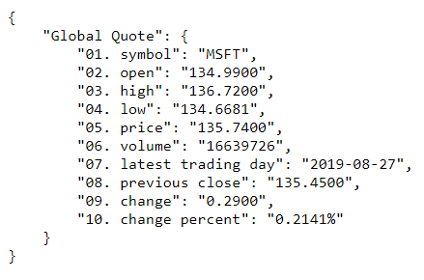
Alpha Vantage API
Example URL: https://www.alphavantage.co/query?function=GLOBAL_QUOTE&symbol=MSFT&apikey=demo
Ran into issues with Free version (You only get up to 5 API requests per minute and 500 requests per day)
Returns a JSON object

Slide 5
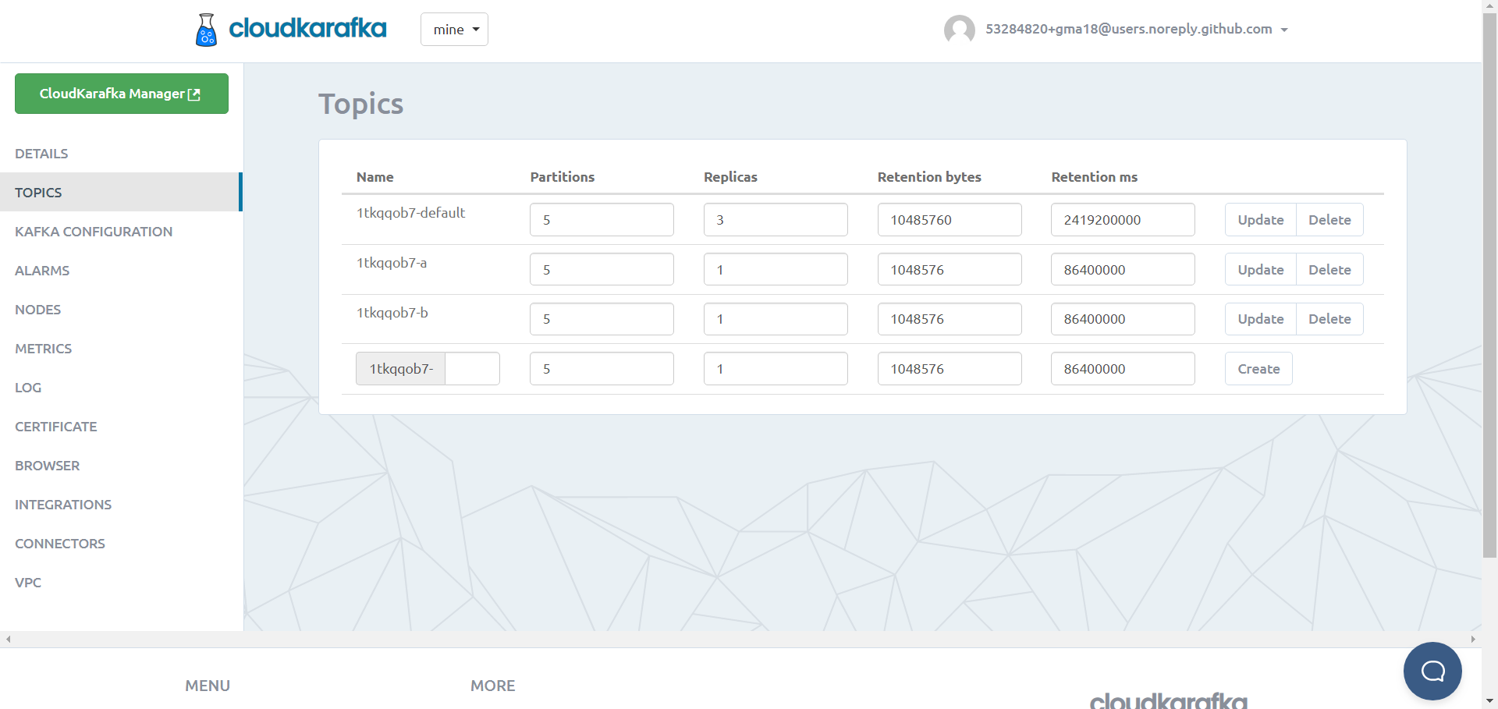
https://www.cloudkarafka.com/

Slide 6
Python Kafka Producer:
https://github.com/gma18/bd230_Final_Project/blob/master/producerBigData230.py

Slide 7
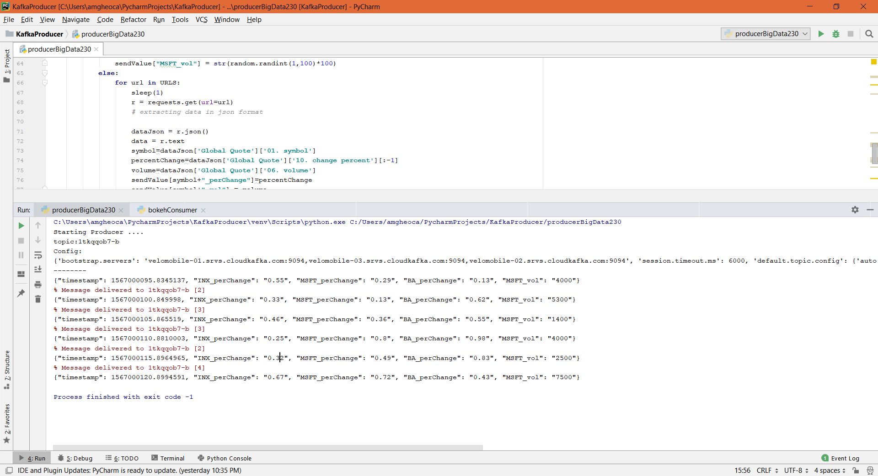
Python Kafka Producer Output

Slide 8
Python Kafka Consumer:
https://github.com/gma18/bd230_Final_Project/blob/master/bokehConsumer.py

Slide 9
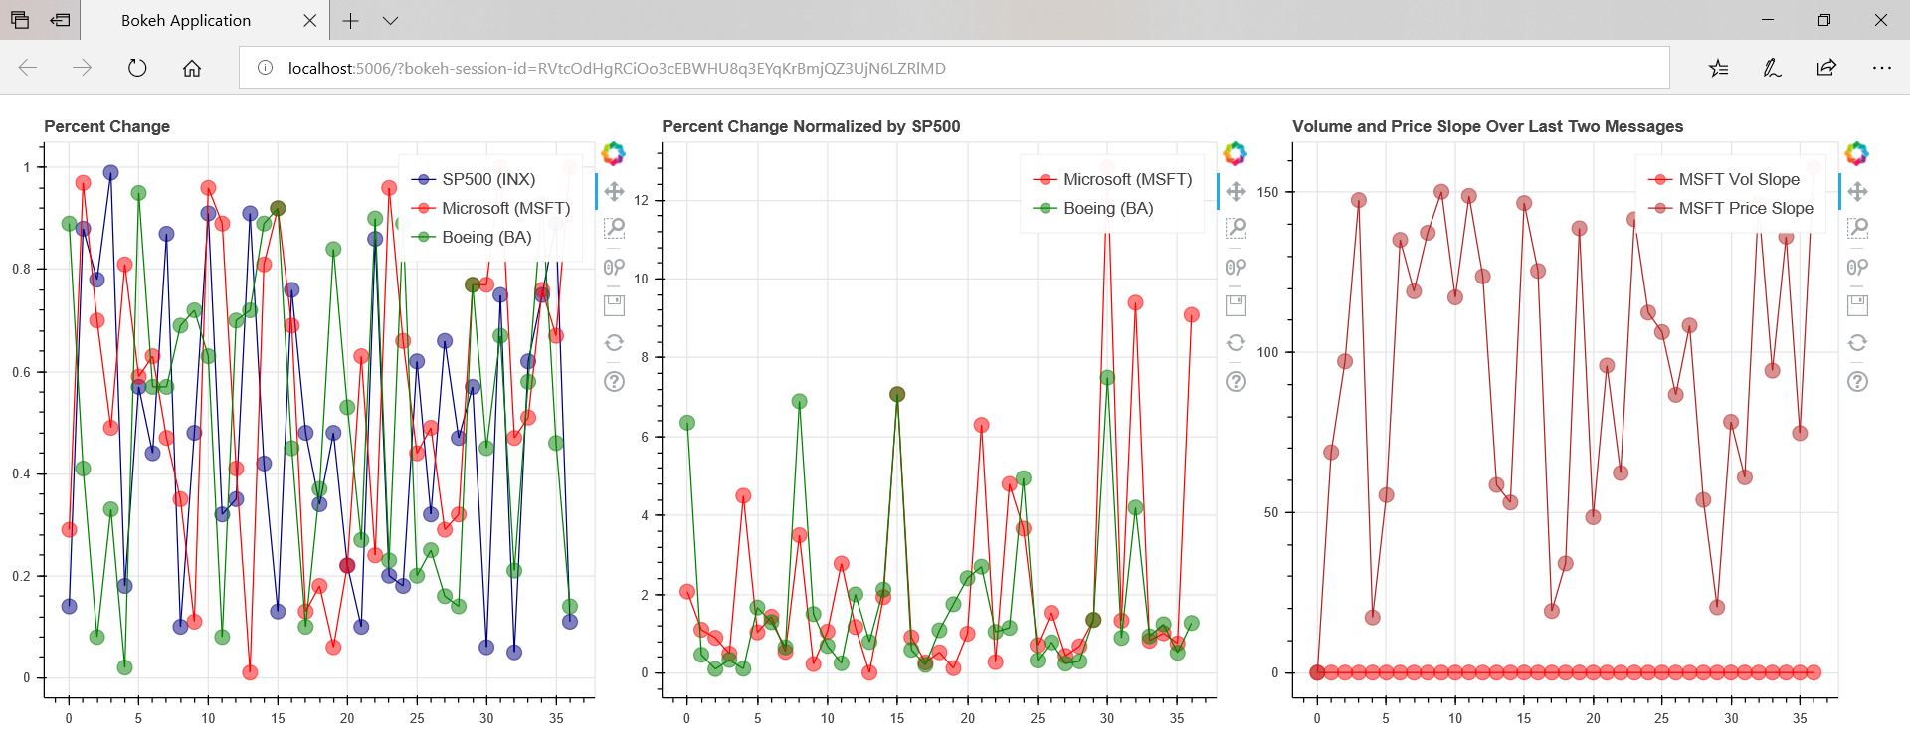
Dashboard

Slide 10
